Slide 1
unittest framework
Testing framework in python

Slide 2
Introduction
A unit test is a test that operates on an individual unit of software. A unit test aims to validate that the tested unit works as designed.
A unit is often a small part of a program that takes a few inputs and produces an output. Functions, methods, and other callables are good examples of units that you’d need to test.
Python standard library has a testing framework named “unittest”
It is used to write automated tests for your code.
The unittest package has an object-oriented approach where test cases derived from a base class, which has several useful methods.

Slide 3
Unittest framework
The framework uses an object-oriented approach and supports some essential concepts that facilitate test creation, organization, preparation, and automation:
Test case: An individual unit of testing. It examines the output for a given input set.
Test suite: A collection of test cases, test suites, or both. They’re grouped and executed as a whole.
Test fixture: A group of actions required to set up an environment for testing. It also includes the teardown processes after the tests run.
Test runner: A component that handles the execution of tests and communicates the results to the user.
Note : the test scripts written in python must start with “test_”

Slide 4
TestCase class
The unittest package defines the TestCase class, which is primarily designed for writing unit tests.
To start writing your test cases, you just need to import the class and subclass it.
Then, you’ll add methods whose names should begin with test.
These methods will test a given unit of code using different inputs and check for the expected results.
Verify the example beside , to know the usage of TestCase class
abs() : it returns absolute positive value of an integer
.assertEqual() method of TestCase class used to verify the values passed to it are equal are not
import unittest
class TestAbsFunction(unittest.TestCase):
def test_positive_number(self):
self.assertEqual(abs(10), 10)
def test_negative_number(self):
self.assertEqual(abs(-10), 10)
def test_zero(self):
self.assertEqual(abs(0), 0)

Slide 5
Running unittest tests
Once you’ve written the tests, you need a way to run them. You’ll have at least two standard ways to run tests with unittest:
Make the test module executable
To make a test module executable in unittest, you can add the following code to the end of the module:
The main() function from unittest allows you to load and run a set of tests
if __name__ == "__main__":
unittest.main()
Use the command-line interface of unittest
you can run the module as a regular Python script
$python3 test_absfunction.py
.........
----------------------------------------------------------------------
Ran 9 tests in 0.000s
OK

Slide 6
verbosity argument of main()
the main() function takes the verbosity argument as one. With this argument, you can tweak the output’s verbosity, which has three possible values:
0 for quiet
1 for normal
2 for detailed
If you want to make the detailed output more descriptive visible in unittest output , then you can add docstrings to your tests like in the following code snippet:
def test_upper(self):
"""Test that 'foo' is converted to 'FOO'."""
self.assertEqual('foo'.upper(), 'FOO')
vlab@lochu:~/Desktop/unittest_py$ python3 test_string.py
test_upper (__main__.TestStringMethods)
Test that 'foo' is converted to 'FOO'. ... ok
----------------------------------------------------------------------
Ran 1 tests in 0.000s
OK

Slide 7
Sample code
import unittest
class TestStringMethods(unittest.TestCase):
def test_upper(self):
"""Test that 'foo' is converted to 'FOO'."""
self.assertEqual('foo'.upper(), 'FOO')
def test_isupper(self):
"""Test string case checking."""
self.assertTrue('FOO'.isupper())
self.assertFalse('Foo'.isupper())
def test_split(self):
"""Test string splitting."""
s = 'hello world'
self.assertEqual(s.split(), ['hello', 'world'])
with self.assertRaises(TypeError):
s.split(2)
if __name__ == '__main__':
unittest.main(verbosity=2)

Slide 8
Skipping tests
The unittest framework also supports skipping individual test methods and even whole test case classes.
Skipping tests allows you to temporarily bypass a test case without permanently removing it from your test suite.
The following decorators will help you with the goal of skipping tests during your test running process:
Decorator | Description
@unittest.skip(reason) | Skips the decorated test
@unittest.skipIf(condition,reason) | Skips the decorated test if condition is true
@unittest.skipUnless(condition,reason) | Skips the decorated test unless condition is true

Slide 9
Example code
import sys
import unittest
class SkipTestExample(unittest.TestCase):
@unittest.skip("Unconditionally skipped test")
def test_unimportant(self):
self.fail("The test should be skipped")
@unittest.skipIf(sys.version_info < (3, 12), "Requires Python >= 3.12")
def test_using_calendar_constants(self):
import calendar
self.assertEqual(calendar.Month(10), calendar.OCTOBER)
@unittest.skipUnless(sys.platform.startswith("win"), "Requires Windows")
def test_windows_support(self):
from ctypes import WinDLL, windll
self.assertIsInstance(windll.kernel32, WinDLL)
if __name__ == "__main__":
unittest.main(verbosity=2)
vlab@lochu:~/Desktop/unittest_py$ python3.12 skip_test.py
test_unimportant (__main__.SkipTestExample.test_unimportant) ... skipped 'Unconditionally skipped test'
test_using_calendar_constants (__main__.SkipTestExample.test_using_calendar_constants) ... ok
test_windows_support (__main__.SkipTestExample.test_windows_support) ... skipped 'Requires Windows'
----------------------------------------------------------------------
Ran 3 tests in 0.002s
OK (skipped=2)

Slide 10
subTest() method
Case : to check whether a number is even or odd
If we want to test with a large input dataset we use .subTest() method
even.py
def is_even(number):
return number % 2 == 0
import unittest
from even import is_even
class TestIsEven(unittest.TestCase):
def test_even_number(self):
for number in [2, 4, 6, -8, -10, -12]:
with self.subTest(number=number):
self.assertEqual(is_even(number), True)
def test_odd_number(self):
for number in [1, 3, 5, -7, -9, -11]:
with self.subTest(number=number):
self.assertEqual(is_even(number), False)
if __name__ == "__main__":
unittest.main(verbosity=2)

Slide 11
Assert methods
The TestCase class provides a set of assert methods. You can use these methods to check multiple conditions while writing your tests.
They let you compare single values, such as numbers and Booleans, and collections, such as lists, tuples, dictionaries, and more.

Slide 12
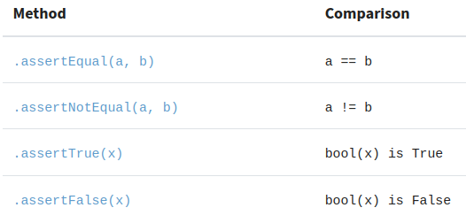
Comparing values
Comparing the result of a code unit with the expected value is a common way to check whether the unit works okay. The TestCase class defines a rich set of methods that allows you to do this type of check:

Slide 13
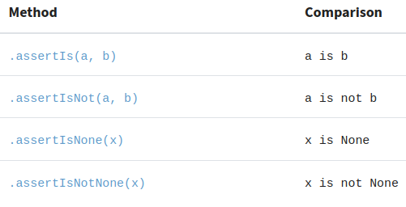
Comparing Objects by Their Identity
TestCase also implements methods that are related to the identity of objects.
An object’s identity is the memory address where the object lives. This identity is a unique identifier that distinguishes one object from another.
It is a read-only property, which means that you can’t change an object’s identity once you’ve created the object.
To check an object’s identity, you’ll use the is and is not operators.

Slide 14
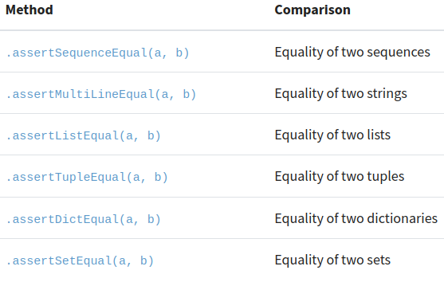
Comparing Collections
Another common need when writing tests is to compare collections, such as lists, tuples, strings, dictionaries, and sets. The TestCase class also has shortcut methods for these types of comparisons
These methods run equality tests between different collection types.

Slide 15
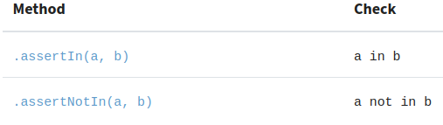
Running Membership Tests
A membership test is a check that allows you to determine whether a given value is or is not in a collection of values. You’ll run these tests with the in and not in operators

Slide 16
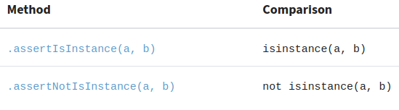
Checking for an Object’s Type
Checking the type of the object that a function, method, or callable returns may be another common requirement in testing.
These two methods are based on the built-in isinstance() function, which you can use to check whether the input object is of a given type.

Slide 17
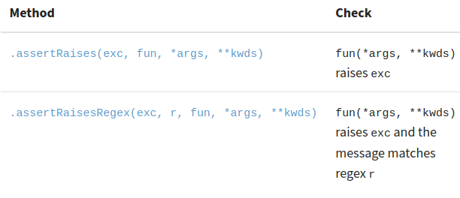
Testing for exceptions
Sometimes, you’ll need to check for exceptions. Yes, sometimes your own code will raise exceptions as part of its behavior.
The first method allows checking for explicit exceptions without considering the associated error message, and the second method checks for exceptions and considers the associated message using regular expressions.

Slide 18
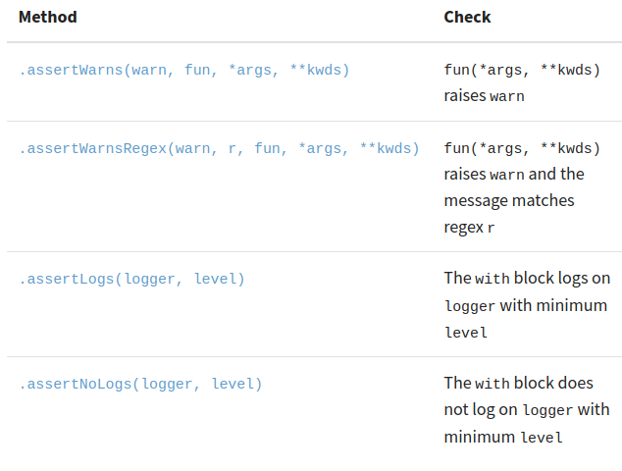
Contd…
The TestCase class also provides some additional assert methods that help you with warnings and logs:

Slide 19
Using unittest From the Command Line
The unittest package also provides a command-line interface (CLI) that you can use to discover and run your tests.
With this interface, you can run tests from modules, classes, and even individual test methods.
$ python -m unittest test_module1 test_module2
$ python -m unittest test_module.TestCase
$ python -m unittest test_module.TestCase.test_method

Slide 20
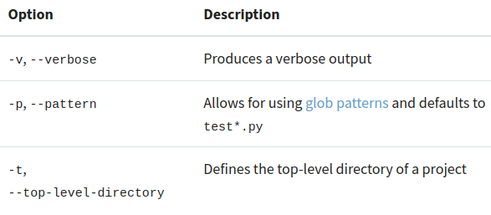
Discovering Tests Automatically
The unittest framework supports test discovery. The test loader can inspect each module in a given directory looking for classes derived from TestCase.
$ python -m unittest discover
This command locates all tests in the current directory, groups them in a test suite, and finally runs them. You can use the python -m unittest as a shortcut for the above command.
You can use the -s or --start-directory command-line options with the discover subcommand to specify the directory where your tests reside. Other command-line options of discover include:

Slide 21
Grouping Your Tests With the TestSuite Class
The unittest framework has a class called TestSuite that you can use to create groups of tests and run them selectively. Test suites can be useful in many situations, including the following:
Complex projects: In complex projects with many features, test suites help you organize tests into manageable and logical groups.
Different testing levels: Test suites allow you to organize your tests according to their testing levels, including unit tests, integration tests, and system tests.
Selective testing: Test suites allow you to create logical groups of tests that you can run selectively, saving time and resources.
Environment-specific testing: Test suites allow group tests that are supposed to run on specific platforms, such as Windows, Linux, macOS, or others

Slide 22
Example code
test_calci.py
import unittest
from calculations import (
add,
mean,
median,
subtract,
)
class TestArithmeticOperations(unittest.TestCase):
def test_add(self):
self.assertEqual(add(10, 5), 15)
self.assertEqual(add(-1, 1), 0)
def test_subtract(self):
self.assertEqual(subtract(10, 5), 5)
self.assertEqual(subtract(-1, 1), -2)
class TestStatisticalOperations(unittest.TestCase):
def test_mean(self):
self.assertEqual(mean([1, 2, 3, 4, 5, 6]), 3.5)
def test_median(self):
self.assertEqual(median([1, 3, 3, 6, 7, 8, 9]), 6)
calci.py
import math
from collections import Counter
def add(x, y):
return x + y
def subtract(x, y):
return x - y
def mean(data):
return sum(data) / len(data)
def median(data):
n = len(data)
index = n // 2
if n % 2:
return sorted(data)[index]
return sum(sorted(data)[index - 1 : index + 1]) / 2

Slide 23
Usage of TestSuite and TextTestRunner
Suppose you need a way to run the arithmetic and statistical tests separately. In this case, you can create test suites.
The TestSuite class allows you to create test suites.
This class constructor takes the tests argument that must be an iterable of tests or other test suites.
manage and run related tests as a single unit
organizing large test sets or running specific subsets of tests.
The “TextTestRunner” is a runner class that executes tests in testsuite
It outputs results to the console in a formatted way, showing test successes, failures, and errors.

Slide 24
Creation of test suite : .run() , .addTest() methods
Create and return a test suite using the TestSuite() constructor with the list of tests as an argument.
To run the suite, you create a TextTestRunner and pass the suite to its .run() method.
def arithmetic_suite():
arithmetic_tests = [
TestArithmeticOperations("test_add"),
TestArithmeticOperations("test_subtract"),
]
return unittest.TestSuite(tests=arithmetic_tests)
if __name__ == "__main__":
suite1 = make_suite()
runner = unittest.TextTestRunner(verbosity=2)
runner.run(suite1)
Use the .addTest() method to add individual tests to an existing suite. To do this, you can do something like the following:
def arithmetic_suite():
arithmetic_suite = unittest.TestSuite()
arithmetic_suite.addTest(TestArithmeticOperations("test_add"))
arithmetic_suite.addTest(TestArithmeticOperations("test_subtract"))
return arithmetic_suite
if __name__ == "__main__":
suite1 = arithmetic_suite()
runner = unittest.TextTestRunner(verbosity=2)
runner.run(suite1)
(or)

Slide 25
.addTests() method
The TestSuite class also has a .addTests() method that you can use to add several tests in one go.
This method takes an iterable of test cases, test suites, or a combination of them.
def statistical_suite():
statistical_tests = [
TestStatisticalOperations("test_mean"),
TestStatisticalOperations("test_median"),
]
statistical_suite = unittest.TestSuite()
statistical_suite.addTests(statistical_tests)
return statistical_suite
if __name__ == "__main__":
suite2 = statistical_suite()
runner = unittest.TextTestRunner(verbosity=2)
runner.run(suite2)
vlab@lochu:~/Desktop/unittest_py$ python3.12 test_calci.py
test_add (__main__.TestArithmeticOperations.test_add) ... ok
test_subtract (__main__.TestArithmeticOperations.test_subtract) ... ok
----------------------------------------------------------------------
Ran 2 tests in 0.000s
OK
test_mean (__main__.TestStatisticalOperations.test_mean) ... ok
test_median(__main__.TestStatisticalOperations.test_median) ... ok
----------------------------------------------------------------------
Ran 2 tests in 0.000s
OK

Slide 26
Creating Suites With the load_tests() Function
Adding tests to a suite manually can be a big task , also be error-prone and represent a maintenance burden.
Therefore , unittest has other tools that can help you create test suites quickly.
The load_tests() function is one of these tools. The function is a hook that unittest provides for customizing test loading and suite creation, either for modules or packages of tests.
The function takes three mandatory arguments. Here’s the signature:
def load_tests(loader, standard_tests, pattern)

Slide 27
Contd…
The load_tests() function defined in the module gets called automatically, and unittest takes care of passing in the required arguments.
The arguments of load_tests() are :
loader: A TestLoader instance, which helps discover and load test cases.
standard_tests: Preloaded tests from the module or package.
pattern: A glob pattern that selects specific tests.
def load_tests(loader, standard_tests, pattern):
suite = unittest.TestSuite()
suite.addTests(loader.loadTestsFromTestCase(TestArithmeticOperations))
suite.addTests(loader.loadTestsFromTestCase(TestStatisticalOperations))
(or)
suite.addTests(loader.standard_tests)
return suite
if __name__ == "__main__":
unittest.main()

Slide 28
Test Fixtures
A test fixture is a preparation that you perform before and after running one or more tests.
The preparations before the test run are known as setup, while the tasks that you perform after the test run are called teardown.
The setup process may involve the creation of temporary files, objects, databases, dataframes, network connections, and so on.
In contrast, the teardown phase may require releasing resources, removing temporary files, closing connections, and similar tasks.

Slide 29
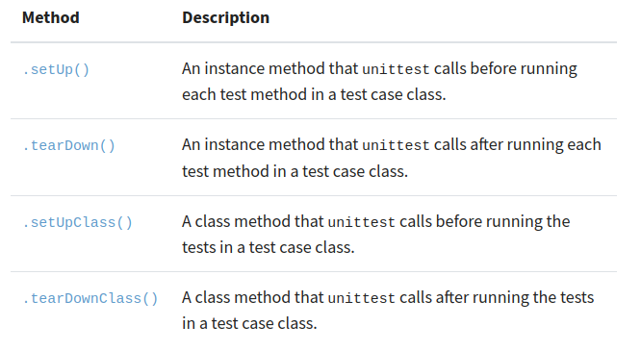
Setup and teardown fixtures
The unittest framework allows you to create setup and teardown fixtures in your test cases classes by overriding the following methods in your TestClass subclasses:
The last two methods are class methods, which means that you need to use the @classmethod decorator to create them
import unittest
class Test(unittest.TestCase):
@classmethod
def setUpClass(cls):
...
@classmethod
def tearDownClass(cls):
...
These methods only take the current test class as an argument. Remember that they run only once per class

Slide 30
Class-Level Fixtures
If you use the .setUpClass() and .tearDownClass() class methods, then you can create class-level fixtures.
This type of fixture only runs once per test case class.
The .setUpClass() method runs before the test methods, and .tearDownClass() runs after all the test methods have run
This behavior is known as shared fixtures because all the test methods depend on a single setup and teardown run.
Note that shared fixtures break test isolation. In other words, the results of a test will depend on previously run tests. So, they should be used with care.

Slide 31
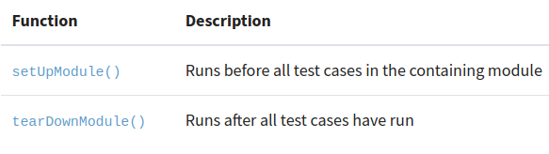
Module-level fixtures
These fixtures run once per module. The setup fixture runs before all the test cases in the module, and the teardown fixture runs after all the test cases in the module have run.
If an exception occurs in the setUpModule() function, then none of the tests in the module run, and the tearDownModule() function won’t run either.
If the raised exception is a SkipTest exception, then the module will be reported as skipped instead of an error.
To create module-level fixtures, you need to use module-level functions rather than methods on a TestCase subclass. The required functions are the following:

Slide 32
Testing With Fake Objects: unittest.mock
What Is Mock?
Mock is a general-purpose class in unittest.mock that lets you create a "fake" object. You can configure this fake object to mimic a real object by defining attributes like .return_value, methods, or properties that it should expose.
How Does Mock Work?
A Mock object has the following capabilities:
Can Replace Real Objects : You can use it in place of a real object (like a function, method, or class) to simulate its behavior.
Tracks Calls : A Mock object keeps track of how it was called (e.g., arguments passed, number of calls, etc.). This is useful for verifying behavior during a test.
Configurable Behavior : You can specify what the Mock should do when called, such as:
Returning a specific value with .return_value
Raising exceptions with .side_effect
Simulating methods or attributes

Slide 33
Use of unittest.mock
Basic Mock
from unittest.mock import Mock
# Create a mock object
mock_func = Mock()
# Set the mock's return value
mock_func.return_value = "Hello, Mock!"
# Call the mock as if it were a function
result = mock_func()
# Output
print(result) # Output: "Hello, Mock!"
2. Mocking a method
from unittest.mock import Mock
# Create a mock object
mock_func = Mock()
# Set the mock's return value
mock_func.return_value = "Hello, Mock!"
# Call the mock as if it were a function
result = mock_func()
# Output
print(result) # Output: "Hello, Mock!"
3. Mocking a attribute
from unittest.mock import Mock
# Create a mock object
mock_func = Mock()
# Set the mock's return value
mock_func.return_value = "Hello, Mock!"
# Call the mock as if it were a function
result = mock_func()
# Output
print(result) # Output: "Hello, Mock!"

Slide 34
Returning a Specific Value with .return_value
You can use the .return_value property to specify what a mock should return when called.
from unittest.mock import Mock
# Create a mock object
mock_function = Mock()
# Configure the mock to return a specific value
mock_function.return_value = "Hello, Mock!"
# Call the mock function
result = mock_function()
# Output
print(result) # Output: "Hello, Mock!"

Slide 35
Raising Exceptions with .side_effect
Use .side_effect to make the mock raise an exception or return different results.
1: Raising an Exception
from unittest.mock import Mock
# Create a mock object
mock_function = Mock()
# Configure the mock to raise an exception
mock_function.side_effect = ValueError("An error occurred!")
# Call the mock function (will raise the exception)
try:
mock_function()
except ValueError as e:
print(e) # Output: "An error occurred!"
2: Returning Different Values Sequentially
from unittest.mock import Mock
# Create a mock object
mock_function = Mock()
# Configure the mock to return different values on each call
mock_function.side_effect = [1, 2, 3]
# Call the mock function multiple times
print(mock_function()) # Output: 1
print(mock_function()) # Output: 2
print(mock_function()) # Output: 3

Slide 36
Tracking Calls using unittest.mock
Mocks keep track of how they are called. You can verify calls during testing.
call_count tells you how many times the mock was called.
call_args_list keeps track of all calls and their arguments.
from unittest.mock import Mock
# Create a mock object
mock_function = Mock()
# Call the mock multiple times
mock_function(1, 2)
mock_function(3, 4)
# Check the number of calls
print(mock_function.call_count) # Output: 2
# Check the arguments passed to the first call
print(mock_function.call_args_list[0]) # Output: call(1, 2)
# Check all call arguments
print(mock_function.call_args_list) # Output: [call(1, 2), call(3, 4)]

Slide 37
References:
https://github.com/lochu-55/Company_training/tree/main/unittest_py
https://realpython.com/python-unittest/#grouping-your-tests-with-the-testsuite-class

Slide 38
THANK YOU

